Slide 1
Stacks

Slide 2
Abstract Data Types (ADT)
abstract data types are used to model different types of data structures
an abstract data type specifies how data is to be stored and the operations that can be performed on the data

Slide 3
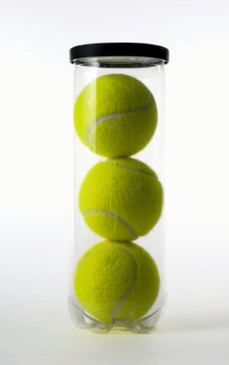

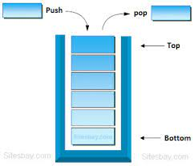
Motivation for Stack
Piles of balls
Piles of books
Stack

Slide 4
Stack as an ADT
a stack is a sequence of elements that can only be accessed from one end, called the top
all insertions and removals take place at the top of the stack
this means the last element in is the first element out, so a stack is a LIFO (last-in first-out) structure

Slide 5
Stack Methods
normal stack operations include
push
adds an element to the top of the stack
pop
removes and returns the top element
peek
retrieves, but does not remove, the top element
size
returns the current size of the stack
isEmpty
true if stack is empty, false otherwise

Slide 6
Stacks in Java
Java provides a Stack class
the behavior of Stack in Java does not strictly adhere to the requirements specified by the ADT for Stack
Stacks and Queues

Slide 7
The JCF Stack Class
Java Collections Framework provides a Stack class
provides methods named push, pop, peek, and empty
a method for searching is also included
the Stack class extends the Vector class, which means that any operation from the Vector class can be used with a Stack object

Slide 8
the JCF Stack Class
Java now discourages the use of the Stack class, instead encouraging use of the Deque interface (to be discussed later in these slides)
Stacks

Slide 9
Stacks
The End

